Slide 1
Welcome to the Domain

Slide 2
Active Directory
Collection of various software systems used to manage fleets of Windows computers
LDAP – Lightweight Directory Access Protocol. Contains user and device information
KERBEROS – Single Sign On
Group Policy – Manages permissions, settings and a slew of things via “polices”. This is the feature that cemented AD in business

Slide 3
Active Directory
Has a steep learning curve and we cannot going to cover every aspect today.
AD is one of the topics VERY much worth exploring further. If you can master AD that is one of the skills that will make you invaluable to a team.

Slide 4
Active Directory
DNS – On a Windows Domain you MUST AD as the DNS server so the LDAP database can store all the information about you and your computer.
DHCP – Also, handled by AD so the LDAP database can tract assigned IPs
File Sharing – Server Message Block (SMB) and
Network File Share (NFS)
Email – Microsoft Exchange Server
Many other roles

Slide 5
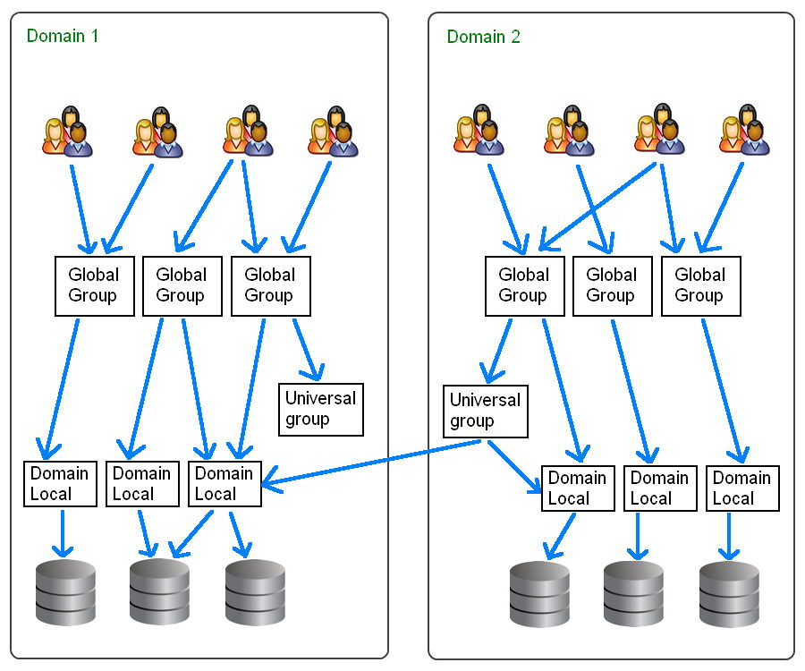
Active Directory Groups
Global Groups and Domain Local Groups only apply within a domain.
Universal Groups apply across domains
Notice no user directly connects to the resources. The groups they belong to inherit permissions and pass them down to the users
Domains use URI format
https://ss64.com/nt/syntax-groups.html

Slide 6
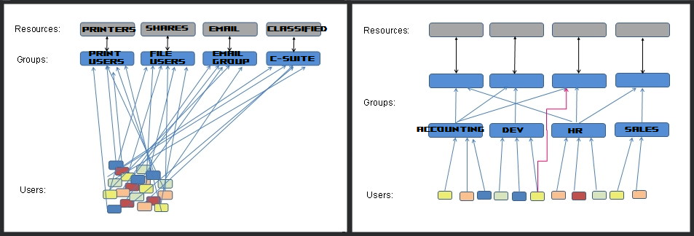
Active Directory
Nested Groups
https://ss64.com/nt/syntax-groups.html

Slide 7
Domain vs Workgroup
Domains are managed by a centralized Domain Controller.
Workgroup are ad-hoc groups of PCs with their own internal set of users and permissions
Workgroups work ok-ish for a couple computers , but becomes VERY difficult to manage once you get over 10-ish computers

Slide 8
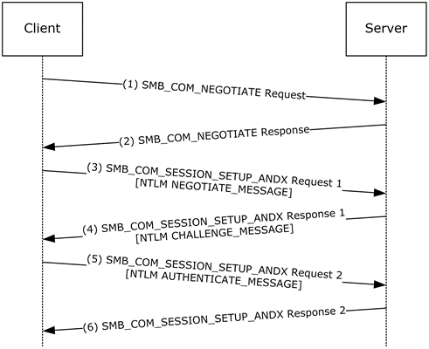
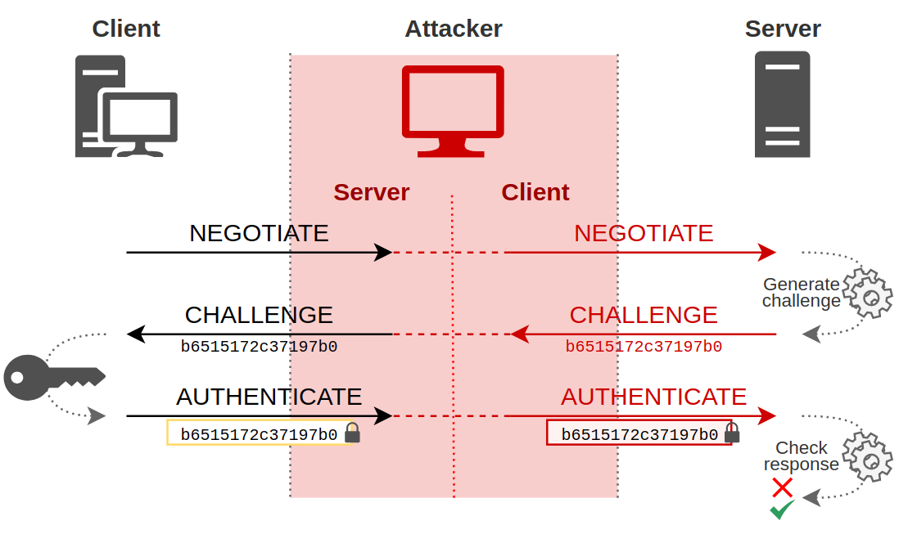
NTLMv2
Obsolete, but included for backwards compatibility
https://learn.microsoft.com/en-us/openspecs/windows_protocols/ms-nlmp/c083583f-1a8f-4afe-a742-6ee08ffeb8cf
https://en.hackndo.com/ntlm-relay/

Slide 9
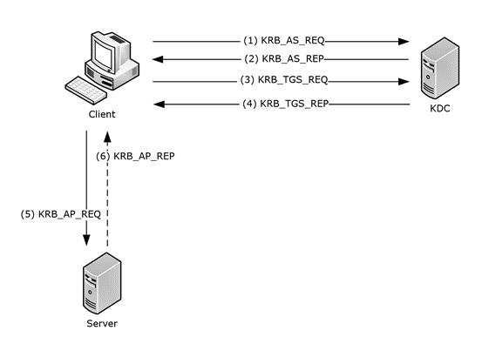
Kerberos
(1) Request ticket-granting ticket (TGT)
(2) Grants TGT and Session Key
(3) Request Authorization for service
(4) Grants Resource Ticket and Session Key
(5) Request Service From Service Server
(6) Service Server Grants access
https://learn.microsoft.com/en-us/openspecs/windows_protocols/ms-kile/b4af186e-b2ff-43f9-b18e-eedb366abf13

Slide 10
NET Command
Display a list of local users: net user
Add a local user: net user <user_name> /add
Delete a user: net user <user_name> /delete
Reset a local password: net user <user_name> <password>
Enable an administrator account: net user administrator /active:yes
Run a command as an administrator: runas /user:<user_name> <program_name>
Add a local user to a group: net localgroup <group_name> <user_name> /add
Delete a local user from a group: net localgroup <group_name> <user_name> /delete
Create a local group: net localgroup <group_name> /add
Delete a local group: net localgroup <group_name> /delete

